Slide 1


Slide 2
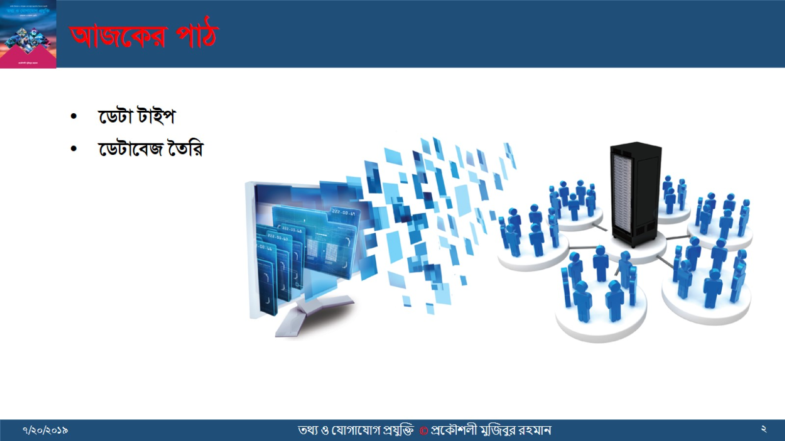
AvR‡Ki cvV

Slide 3
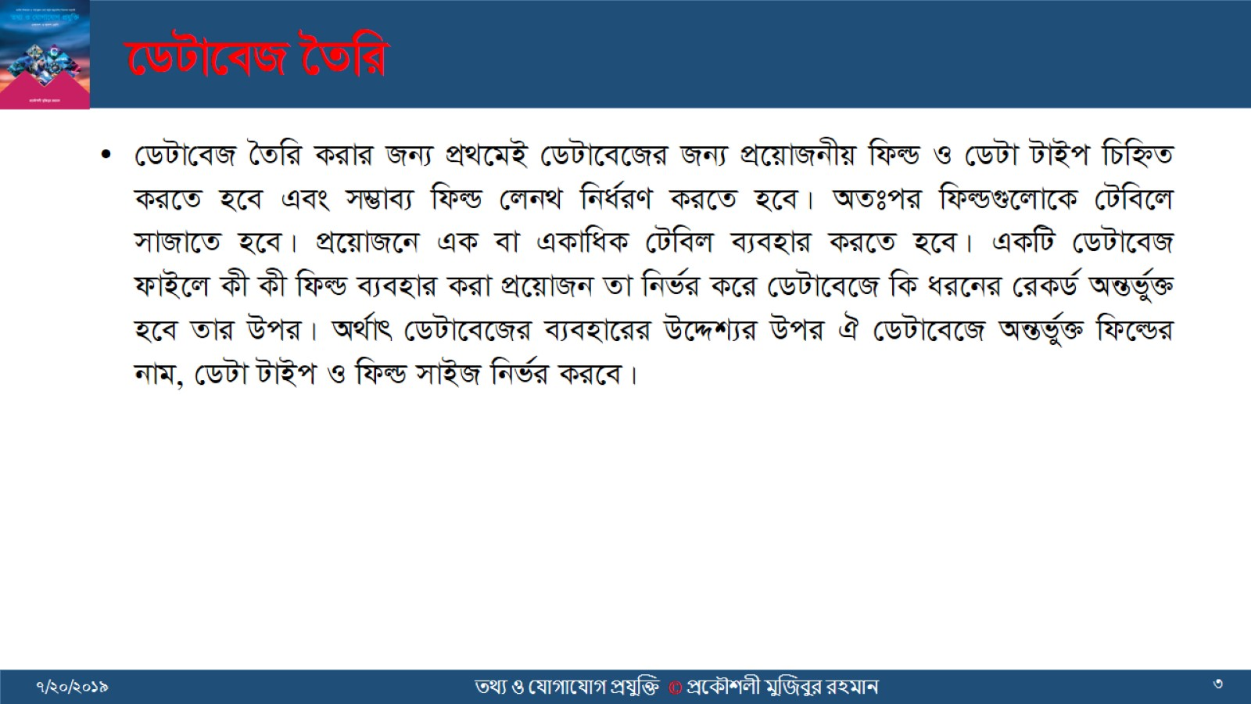
‡WUv‡eR ‰Zwi

Slide 4
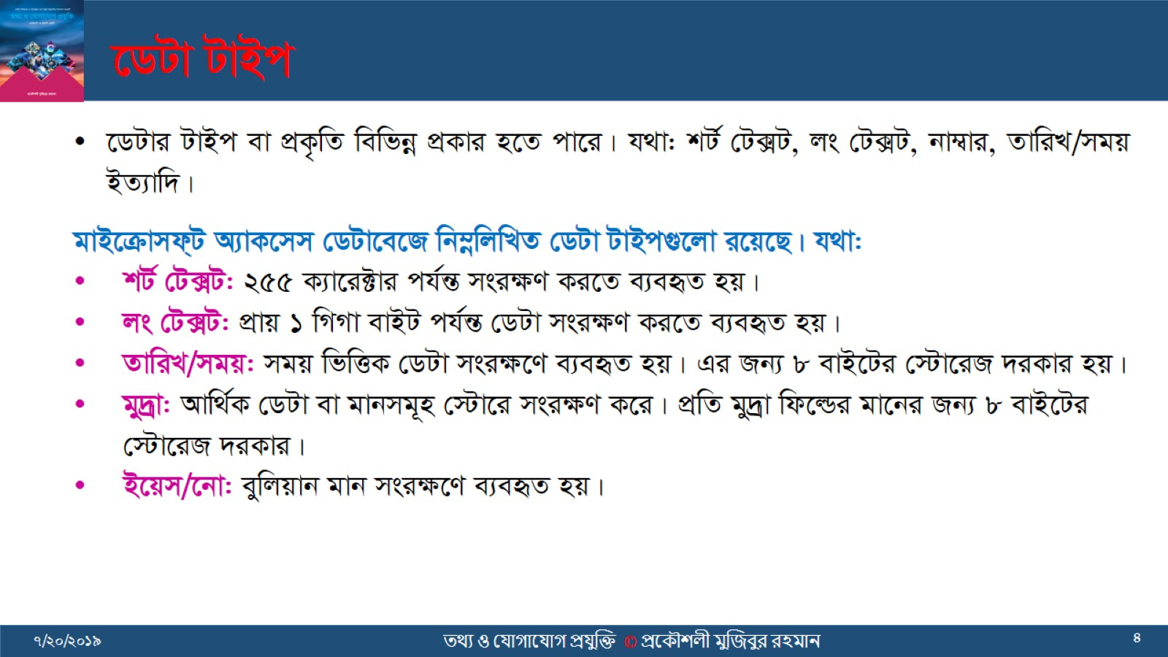
‡WUv UvBc

Slide 5
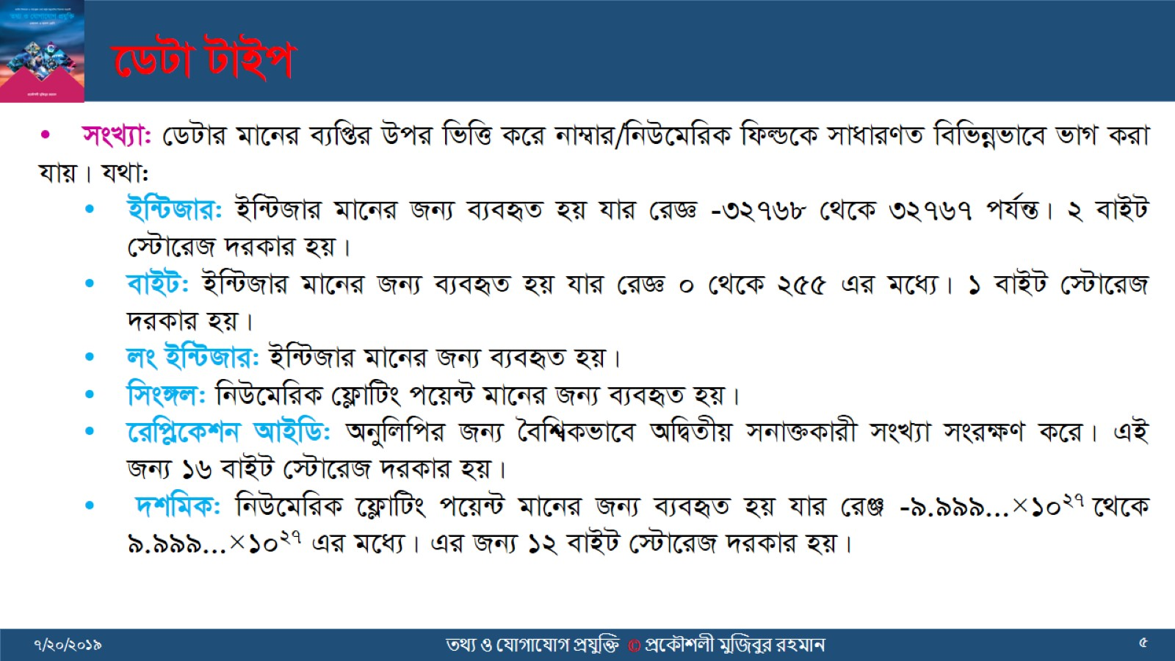
‡WUv UvBc

Slide 6
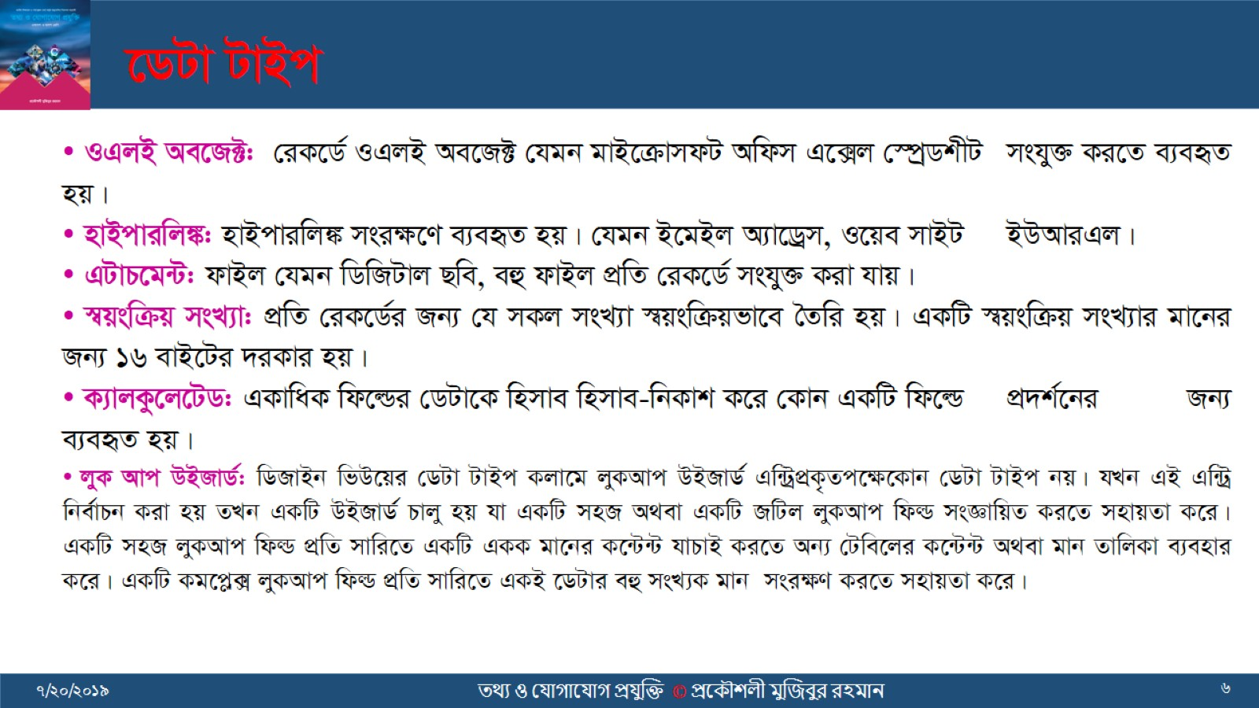
‡WUv UvBc

Slide 7


